Slide 1
AMMM Project
Anastasios Papazafeiropoulos
Nikolaos Bellos 2023

Slide 2
Problem: Formal Definition
Given a positive integer n, the goal is to find a set of n different natural numbers t0, t1, ..., tn-1 such that:
No two different pairs of numbers in the set are the same distance apart.
The difference between the maximum and the minimum numbers in the set is minimized.
The example provided demonstrates that the sets {0, 1, 4, 9, 11} and {0, 2, 7, 8, 11} are optimal when n = 5, as they minimize the difference between the maximum and minimum numbers while ensuring no two pairs have the same distance apart.

Slide 3
Integer Linear Programming Model
Parameters (Inputs):
n → number of different natural numbers
Outputs:
A set of n natural numbers
A fitness score N → difference between the first and the last element of the set.
Variables:
X_{t}[n] , n: 1..N
X_{d}[n_{i}][n_{j}] , n_{i}: 1..N, n_{j}: 1..N

Slide 4



Integer Linear Programming Model
Constraints:
1)
2)
3)
*4)

Slide 5
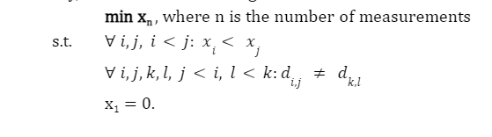
Integer Linear Programming Model
Objective function:
minimize x_{n}
Eventually, the ILP is:

Slide 6
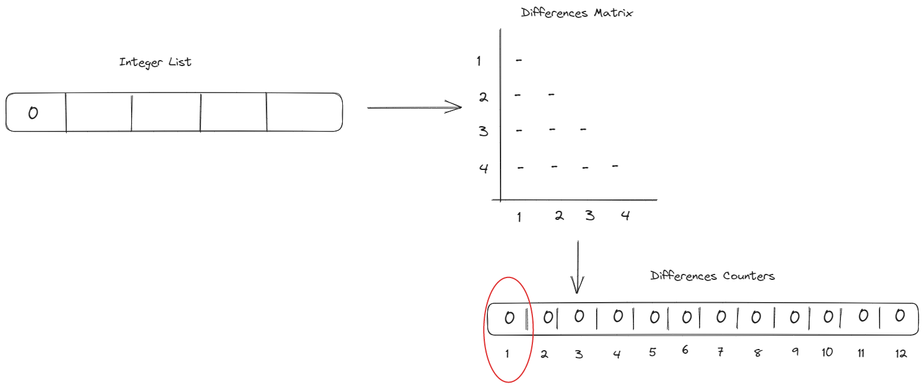
Greedy Constructive

Slide 7
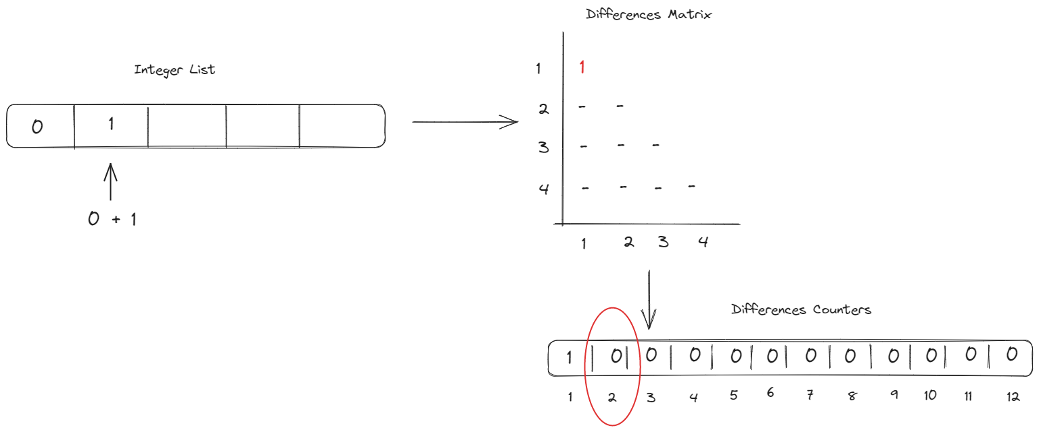
Greedy Constructive

Slide 8
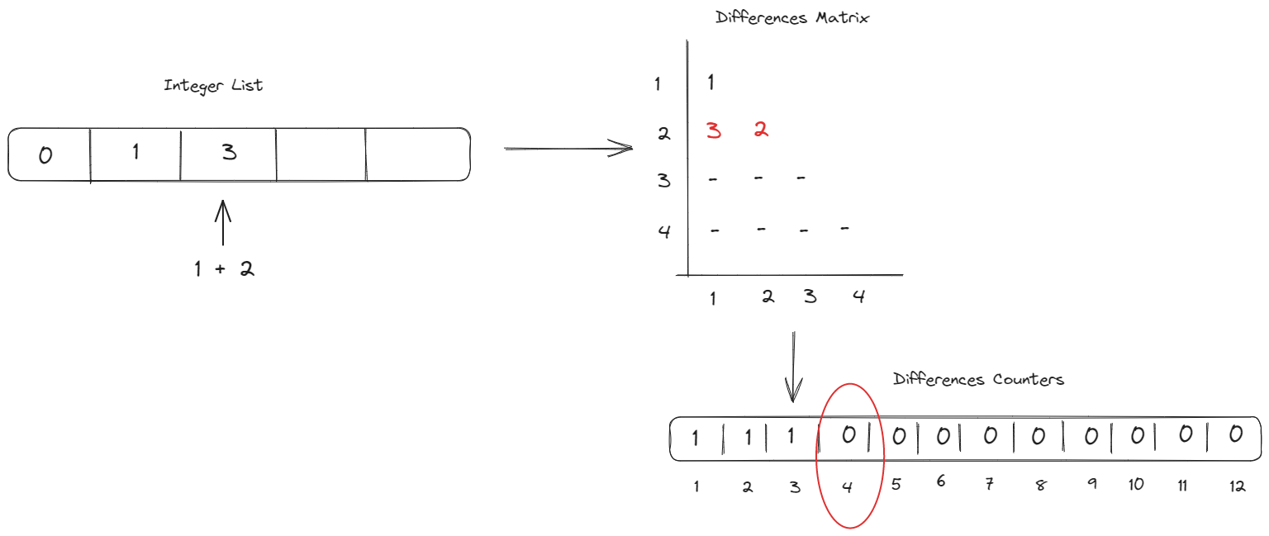
Greedy Constructive

Slide 9
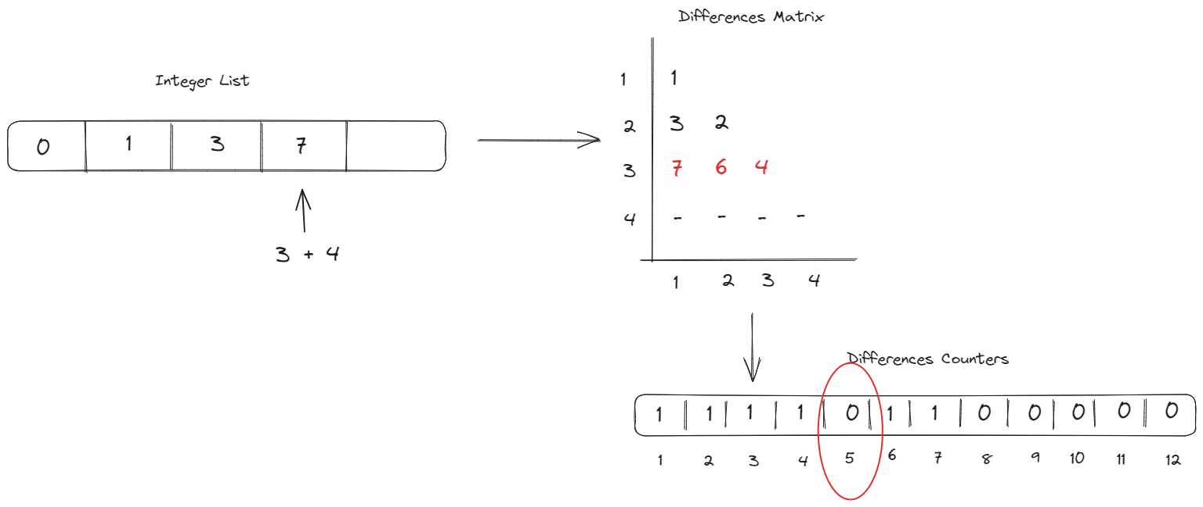
Greedy Constructive

Slide 10
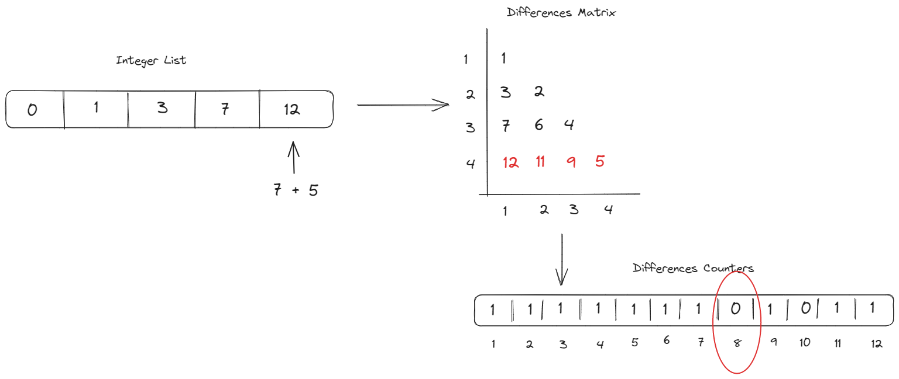
Greedy Constructive

Slide 11
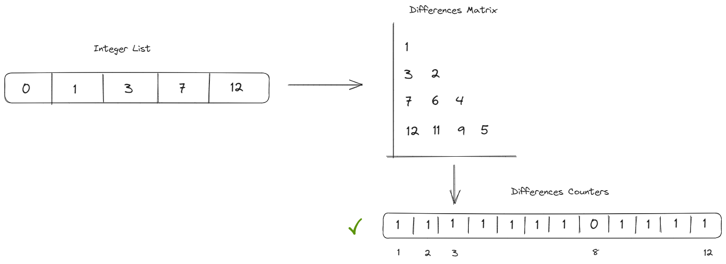
Local Search

Slide 12
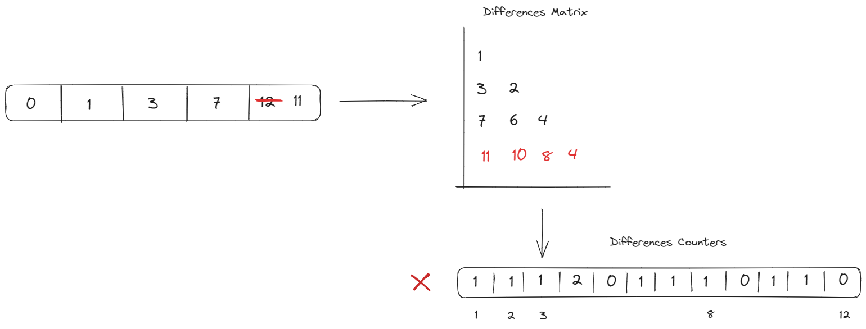
Local Search

Slide 13
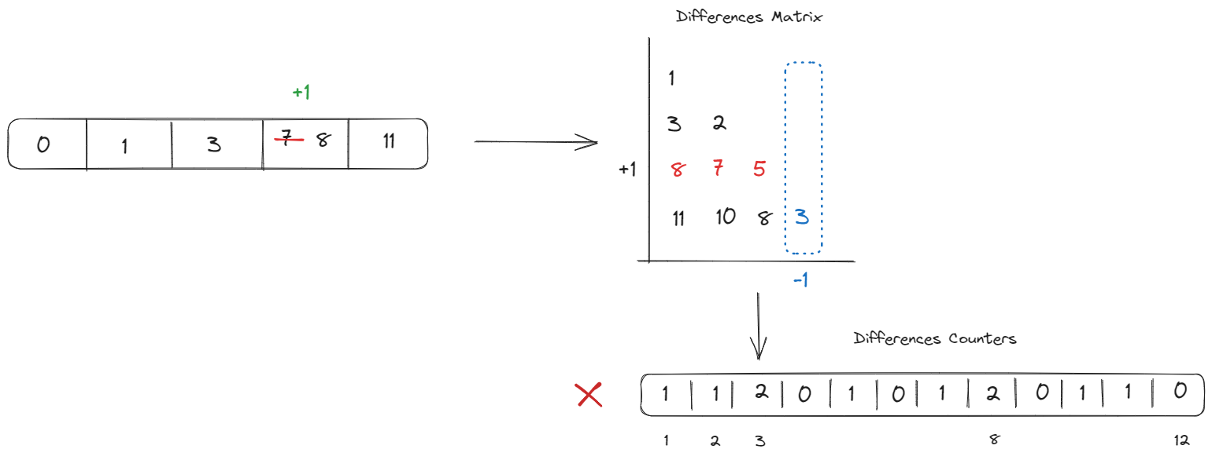
Local Search

Slide 14
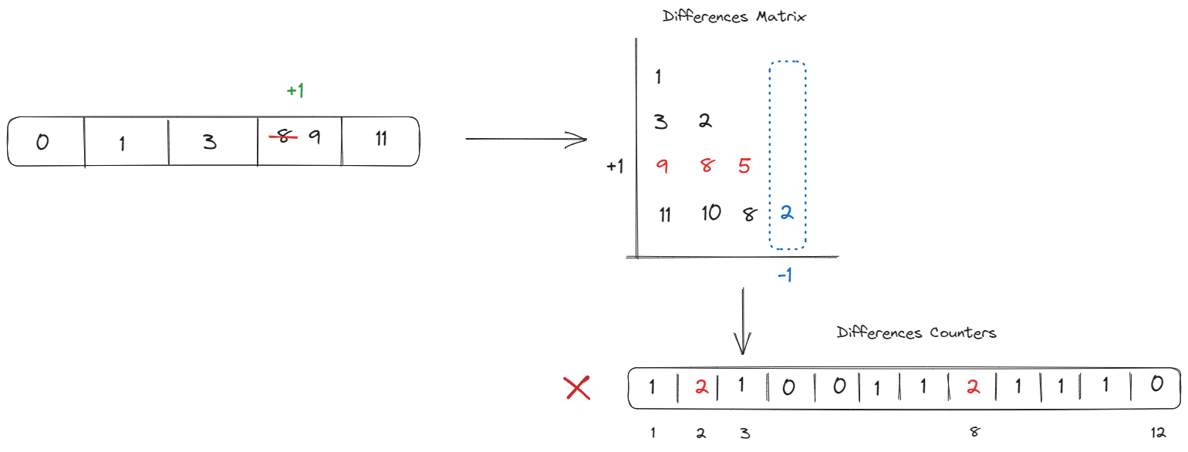
Local Search

Slide 15
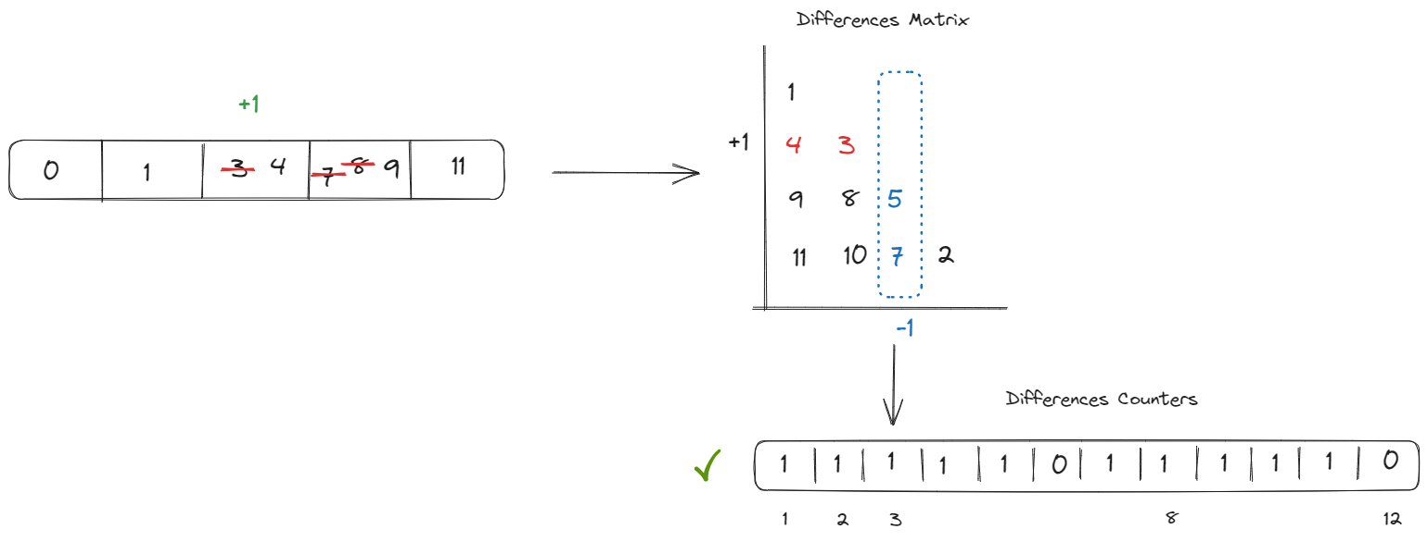
Local Search

Slide 16
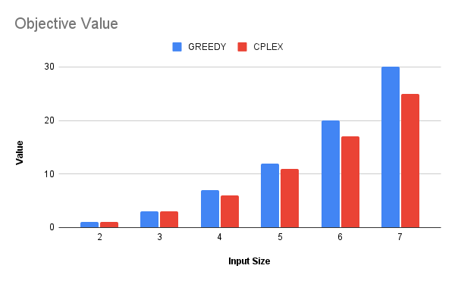
Comparisons - Quality

Slide 17
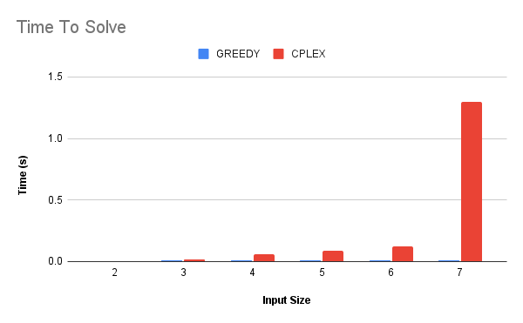
Comparisons - Time

